Slide 1

GLOBAL INSTITUTE OF TECHNOLOGY
Department of Computer Science and Engineering
A
FINAL YEAR PROJECT
on
FarmEasy – Harvestify A ML & DL based Intelligence Project
Presented By:
Nishant Kumar (18EGCS085)
Nitesh Kumar (18EGJCS086)
Himanshu Sharma(18EGJCS051)
Semester and Year: 8th (IV Year)
Submitted to:
Mr. Pradeep Jaha.
Head of Dept.
Session: 2021-22

Slide 2
Outline
Abstract
Introduction
Motivation
Literature Survey
Problem Statement
Objectives and Scope
System Requirements
Architecture
Modules for Training & Testing
Modules for Image Processing
Algorithm
Experimental Result
Applications
Summary
Refrences

Slide 3
Introduction
A simple Machine Learning and Deep Learning based website which recommends the best crop to grow, fertilizers to use and the diseases caught by your crops.
In this project, I present a website in which the following applications are implemented; Crop recommendation, Fertilizer recommendation and Plant disease prediction, respectively.
In the crop recommendation application, the user can provide the soil data from their side and the application will predict which crop should the user grow.
For the fertilizer recommendation application, the user can input the soil data and the type of crop they are growing, and the application will predict what the soil lacks or has excess of and will recommend improvements.
For the last application, that is the plant disease prediction application, the user can input an image of a diseased plant leaf, and the application will predict what disease it is and will also give a little background about the disease and suggestions to cure it.

Slide 4
Motivation
Farming is one of the major sectors that influences a country’s economic growth.
In country like India, majority of the population is dependent on agriculture for their livelihood. Many new technologies, such as Machine Learning and Deep Learning, are being implemented into agriculture so that it is easier for farmers to grow and maximize their yield.
Machine learning in agriculture used to improve the productivity and quality of the crops in the agriculture sector.
AI can provide farmers with real-time insights from their fields, allowing them to identify areas that need irrigation, fertilization, or pesticide treatment.

Slide 5
Literature Survey
Sr. No | Journal Name And Publication Year | Title | Technology | Identify disease
1 | International Conference on Internet of Things and Intelligence System Analysis [IEEE-2018] | Krish Mitr (Farmer Friend): Using Machine Learning to identify Disease in Plants. | TensorFlow Framework by CNN Model. | Calculate CNN Model.
2 | International Conference for Convergence in Technology[IEEE-2018] | Mango Leaf Deficiency Detection using digital image processing and ML. | Image Processing . | Calculate only Leaf Area.
3 | International Research Journal of Engineering and Technology[IEEE-2018] | Plant Disease Detection using ML. | Canny Edge detection Algorithm. | Disease in crop mostly on leaves.
4 | international Conference on Design Innovations for 3Cs Compute Communicate Control (ICDI3C) | Plant Disease Detection using ML. | Image Processing | Disease in crop

Slide 6
Problem Statement
To detect disease on leaves of plant and recommend the pesticide as per the types of disease to Farmer and recommend the crop and Fertilizer based on their soil’s data.
But it’s a Software based application so farmer’s need to check their farm’s soil at Commercials labs or nearby Government Labs like Kisan Seva Kendra (to get the value of Nitrogen and Potassium or other elements in the soil.

Slide 7
Objectives And Scopes
Objectives
  To find the interactions between the disease causing agents and host plants in relation to overall environment.
  To identify various disease in plants.
  To implement a method for preventing the disease and providing management for reducing the losses/damages caused by disease.
  To Recommend the best fertilizers.
  To Recommend the best crop.
Scopes
  Prevent disease on plants for Farmers.
  Help out the pesticide company in predicting the new pesticide solutions.

Slide 8
System Requirements
Hardware Requirements
  Processor: Intel Core i5 8th gen
  RAM: 8GB
  Hard Disk: Minimum 500 GB
Software Requirements
  Operating System: Windows 10 Onwards
  Programming Language: Python 3.8 64 Bit.
  Browser: Google Chrome
  Frontend Languages: HTML/CSS/JS
  Framework: Flask
  Tools: VsCode/Jupyter Notebook/Google Collab.

Slide 9
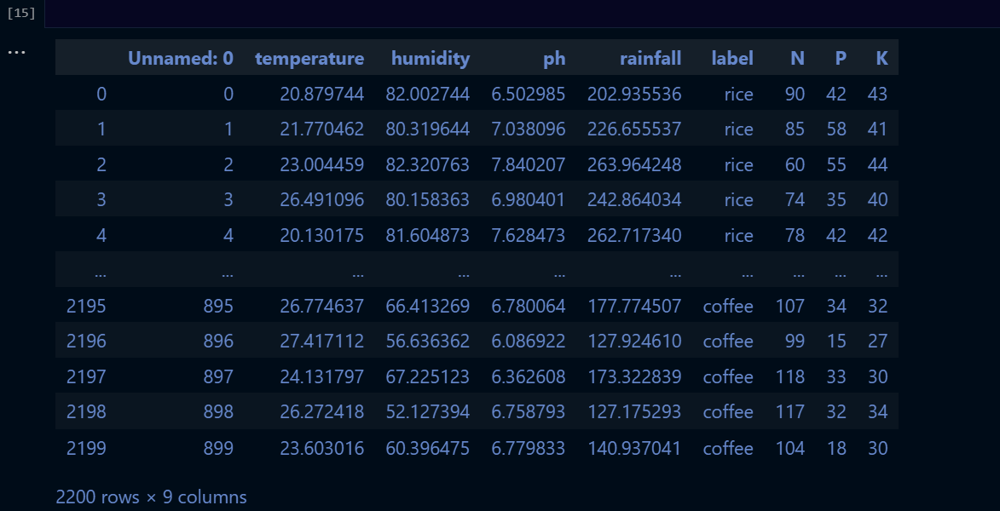
Crop Recommendation
In Crop recommendation we have 2200 rows of data set with 9 columns.
Where columns are Related Humidity, Ph , Rainfall, Nitrogen, Phosphorus, Potassium along with different crops labels.

Slide 10
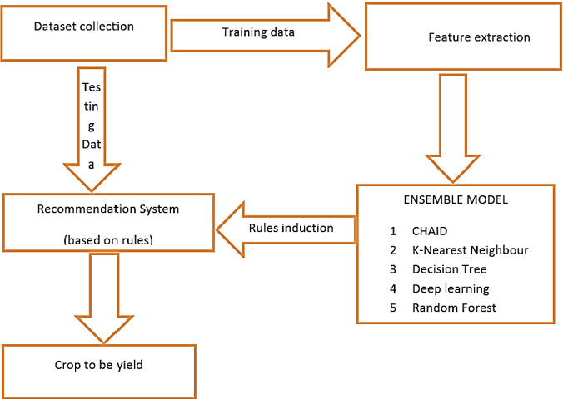
Architecture Model

Slide 11
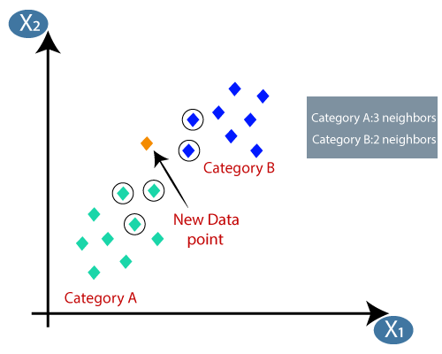
K–Nearest Neighbor
The k-nearest neighbors algorithm, also known as KNN or k-NN, is a non-parametric, supervised learning classifier, which uses proximity to make classifications or predictions about the grouping of an individual data point.
To implement an item based collaborative filtering, KNN is a perfect go-to model and also a very good baseline for recommender system development.

Slide 12
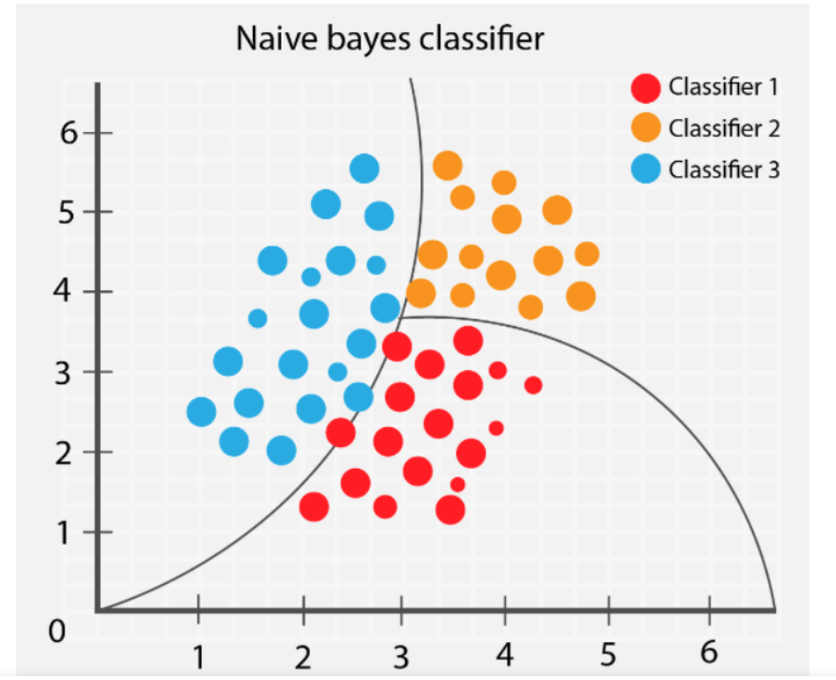
Naive Bayes Algorithm
Naïve Bayes Classifier is one of the simple and most effective Classification algorithms which helps in building the fast machine learning models that can make quick predictions. It is a probabilistic classifier, which means it predicts on the basis of the probability of an object.

Slide 13
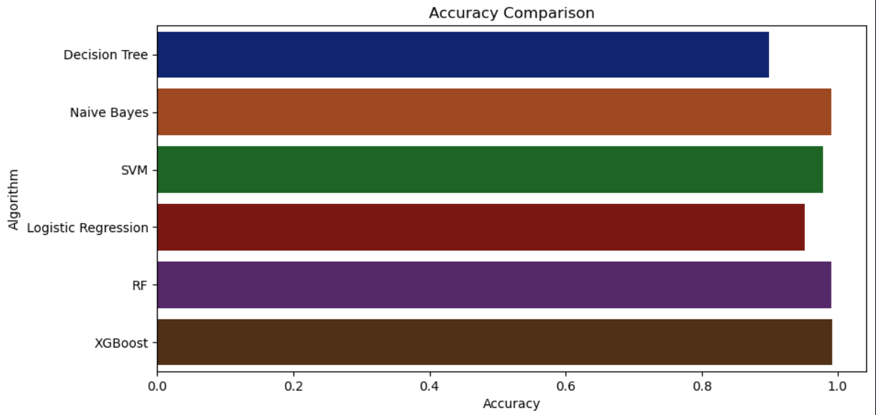
Accuracy Of Different Algos

Slide 14
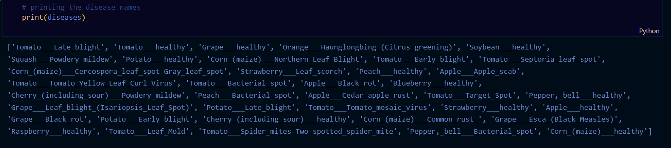
Plant Disease Prediction
In this mainly we have used following types of crop’s leaf to trained the model which are following

Slide 15
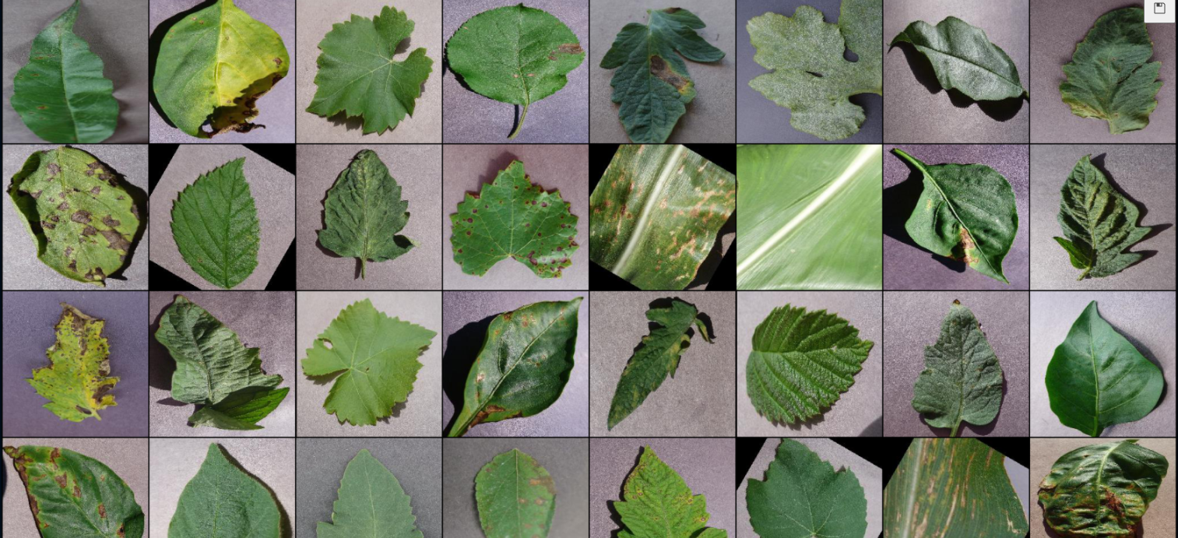
Plant Disease Prediction
Images for first batch of training are following.

Slide 16
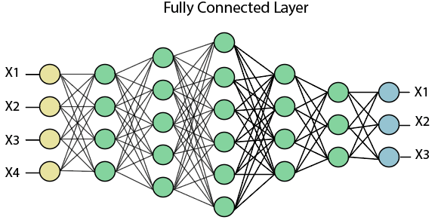
Models for Training & Testing
Fully connected layer
  we flattened our matrix into vector and feed into a fully connected layer like Neural Network.

Slide 17
Models for Training & Testing
Poling Layer
  Reduces the number of parameters when the image are too large types.
  Max Pooling
  Average Pooling
  Sum Pooling
Max Pool with 2*2 filter
1 | 1 | 2 | 4
5 | 6 | 7 | 8
3 | 2 | 1 | 0
1 | 2 | 3 | 4
6 | 8
3 | 4

Slide 18
Models for Training & Testing
Step 1 : Start
Step 2 : Prepare Database (Health/Unhealthy)
Step 3 : Preprocessing Normalization(Size of 64 x 64 )
Step 4 : Train CNN
Step 5 : Real Image from Pc
Step 6 : Preprocessing (Size = 64X64)
Step 7 : Test Network
Step 8 : If probability of healthy > probability unhealthy
Display Healthy Image
otherwise
Display unhealthy image with Solutions
Step 9 : Go to Step 4
Step 10 : End

Slide 19
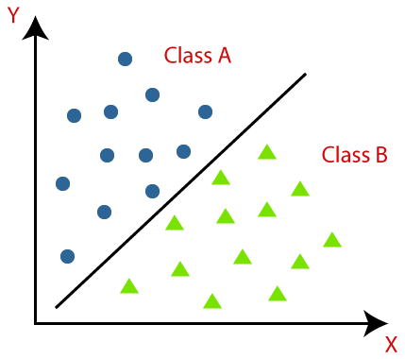
Models for Training & Testing
Classification
  A classification is a process of placing each individual under study in many classes.
  Classification helps to analyze the measurement of an object to identify the classes to which that image belong.
  To establish an efficient relation, analysts use data.

Slide 20
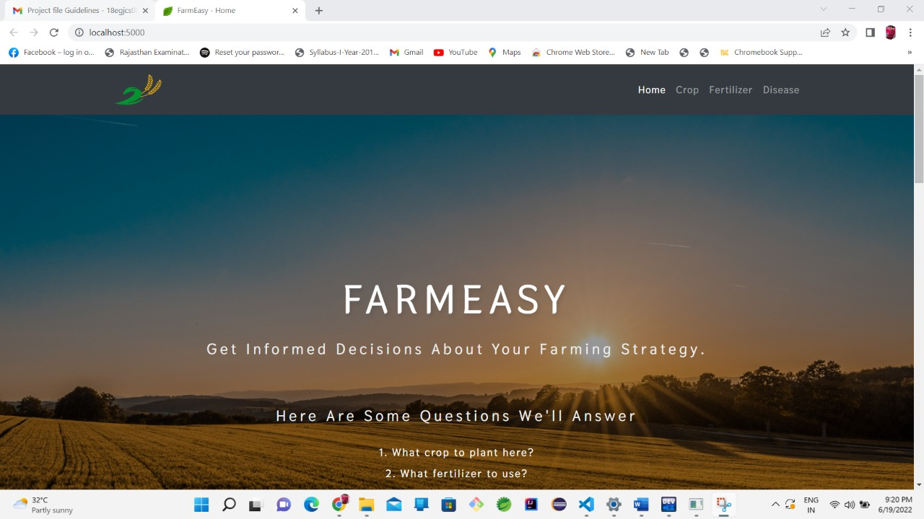
Some Snippet of Project

Slide 21
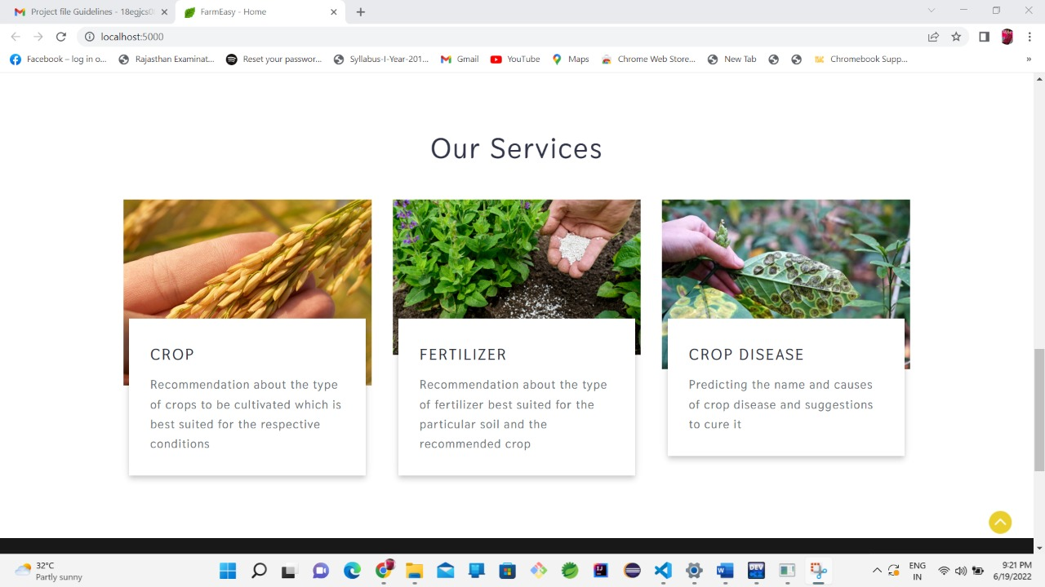
Some Snippet of Project

Slide 22
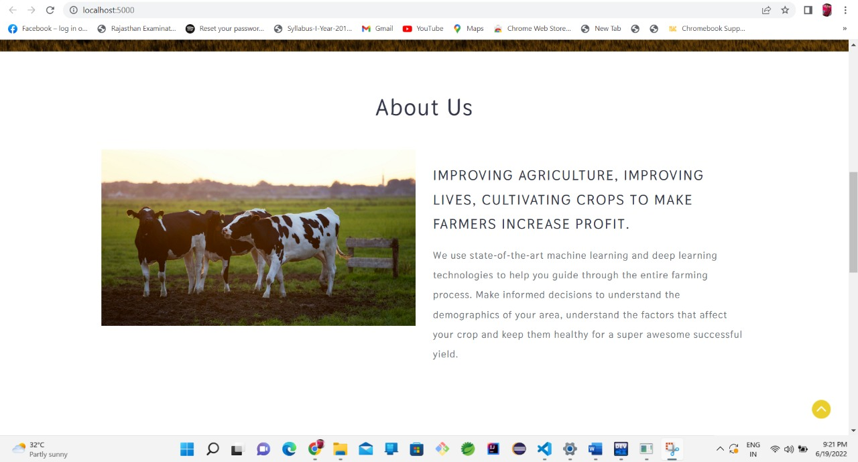
Some Snippet of Project

Slide 23
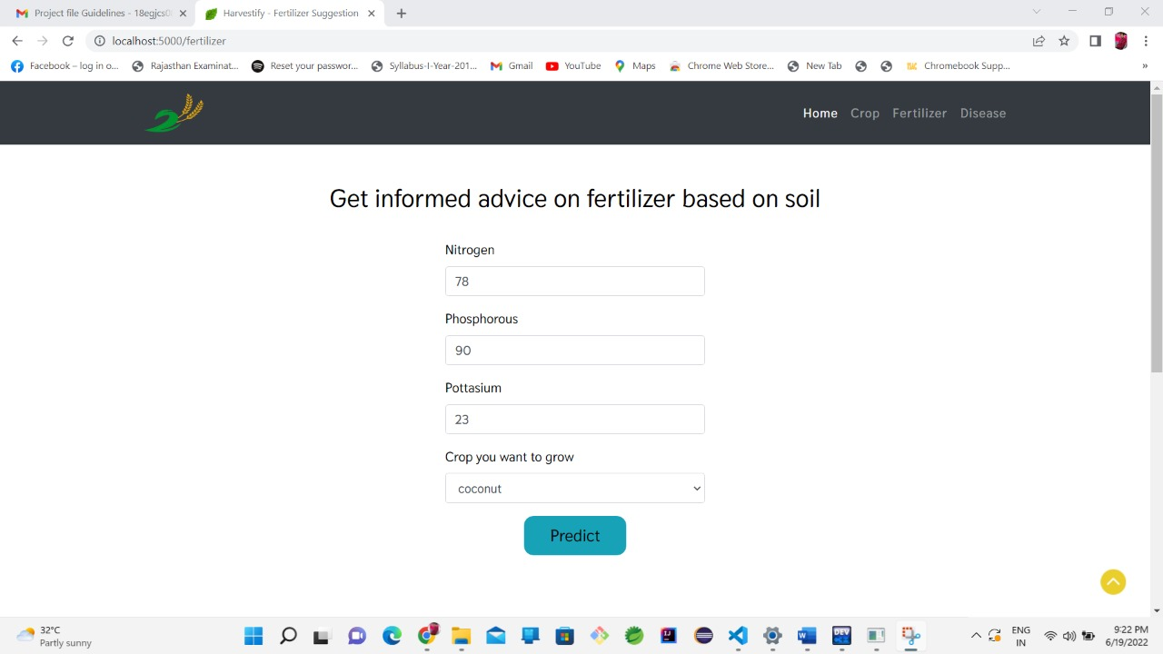
Some Snippet of Project

Slide 24
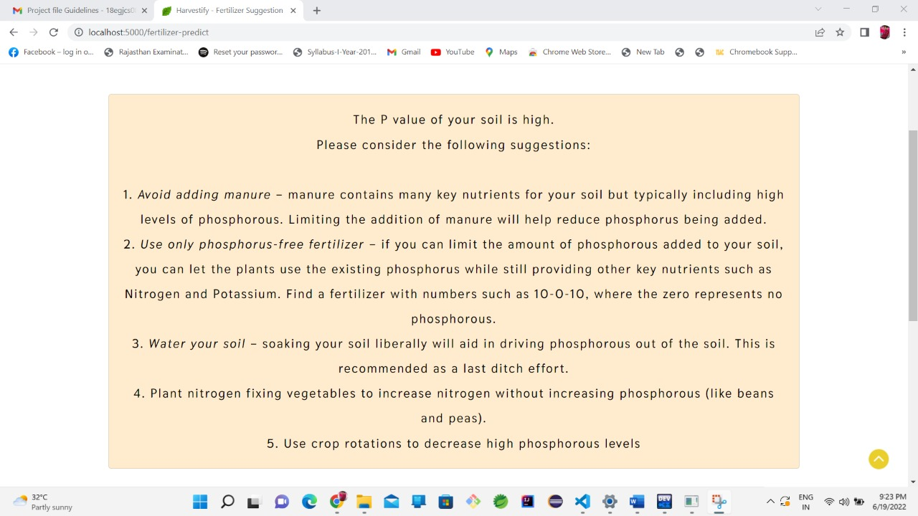
Some Snippet of Project

